Slide 1
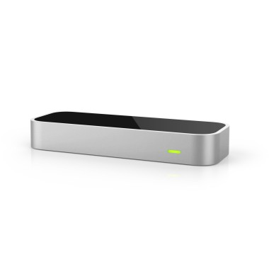
Leap Motion Hurdles

Slide 2
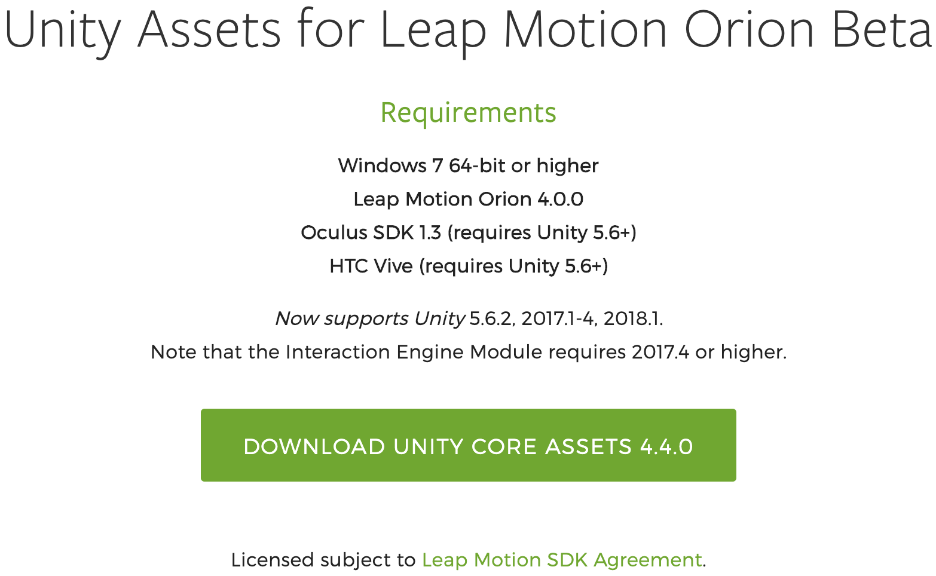

Slide 3
